Slide 1
Week- 9
Session-2
Operations Management
Notes:
If this PowerPoint presentation contains mathematical equations, you may need to check that your computer has the following installed:
1) MathType Plugin
2) Math Player (free versions available)
3) NVDA Reader (free versions available)

Slide 2
Operations Management (OM)
Definition
OM is the management of systems, which transform inputs into value-added products and/or services.
Primary Functions
Organization
Finance
Operations
Marketing
Support Functions – R&D, HR, PR, Accounting, etc.
Notes:
R&D=research and development, HR= human resource, PR=public relation

Slide 3
Value-Added
The difference between the cost of inputs
and the value or price of outputs.
Value added
Inputs
Transformation/
Outputs
Land
Conversion
Goods
Labor
process
Services
Capital
Feedback
Control
Feedback
Feedback

Slide 4
Food Processor
Inputs
Processing
Outputs
Raw Vegetables
Cleaning
Canned
vegetables
Metal Sheets
Making cans
Water
Cutting
Energy
Cooking
Labor
Packing
Building
Labeling
Equipment

Slide 5
Hospital Process
Inputs
Processing
Outputs
Doctors, nurses
Examination
Healthy
patients
Hospital
Surgery
Medical Supplies
Monitoring
Equipment
Medication
Laboratories
Therapy

Slide 6
Manufacturing or Service?
Tangible
Act
Notes:
Manufacturing products are mostly tangible. On the other hand services are mostly related to actions.

Slide 7
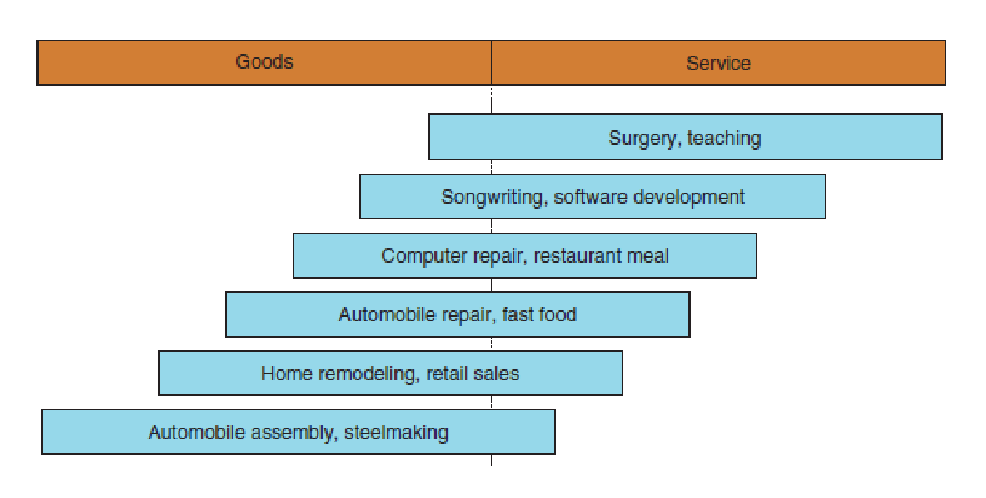
The goods–service continuum
Notes:
These are some real life examples of manufacturing and service firms

Slide 8
Production of Goods vs. Delivery of Services
Production of goods – tangible output
Delivery of services – an act (Intangible)
Service job categories
  Government
  Wholesale/retail
  Financial services
  Healthcare
  Personal services
  Business services
  Education

Slide 9
Manufacturing vs Service
Characteristic
Manufacturing
Service
Output
Tangible
Intangible
Customer contact
Low
High
Uniformity of input
High
Low
Labor content
Low
High
Uniformity of output
High
Low
Measurement of productivity
Easy
Difficult
Opportunity to correct
High
Low
quality problems

Slide 10
Scope of Operations Management
Operations Management includes:
  Forecasting
  Capacity planning
  Scheduling
  Managing inventories
  Assuring quality
  Motivating employees
  Deciding where to locate facilities
  Supply Chain Management (SCM)
  And more . . .

Slide 11
Operations Function
The operations function
  Consists of all activities directly related to producing goods or providing services

Slide 12
Types of Operations
Operations
Examples
Goods Producing
Farming, mining, construction
,
manufacturing, power generation
Storage/Transportation
Warehousing, trucking, mail
service, moving, taxis, buses,
hotels, airlines
Exchange
Retailing, wholesaling,
banking, renting, library, loans
Entertainment
Films, radio and television,
concerts, recording
Communication
Newspapers, radio and television
newscasts, email, telephone,
satellites

